Slide 1
Chapter 5
Selection Statements

Slide 2
Motivation:
We need more types of statements to implement our logic/workflow, etc.

Slide 3
Statements
So far, we’ve used return statements and expression statements.
Most of C’s remaining statements fall into three categories:
Selection statements: if and switch
Iteration statements: while, do, and for
Jump statements: break, continue, and goto. (return also belongs in this category.)
Other C statements:
Compound statement
Null statement

Slide 4
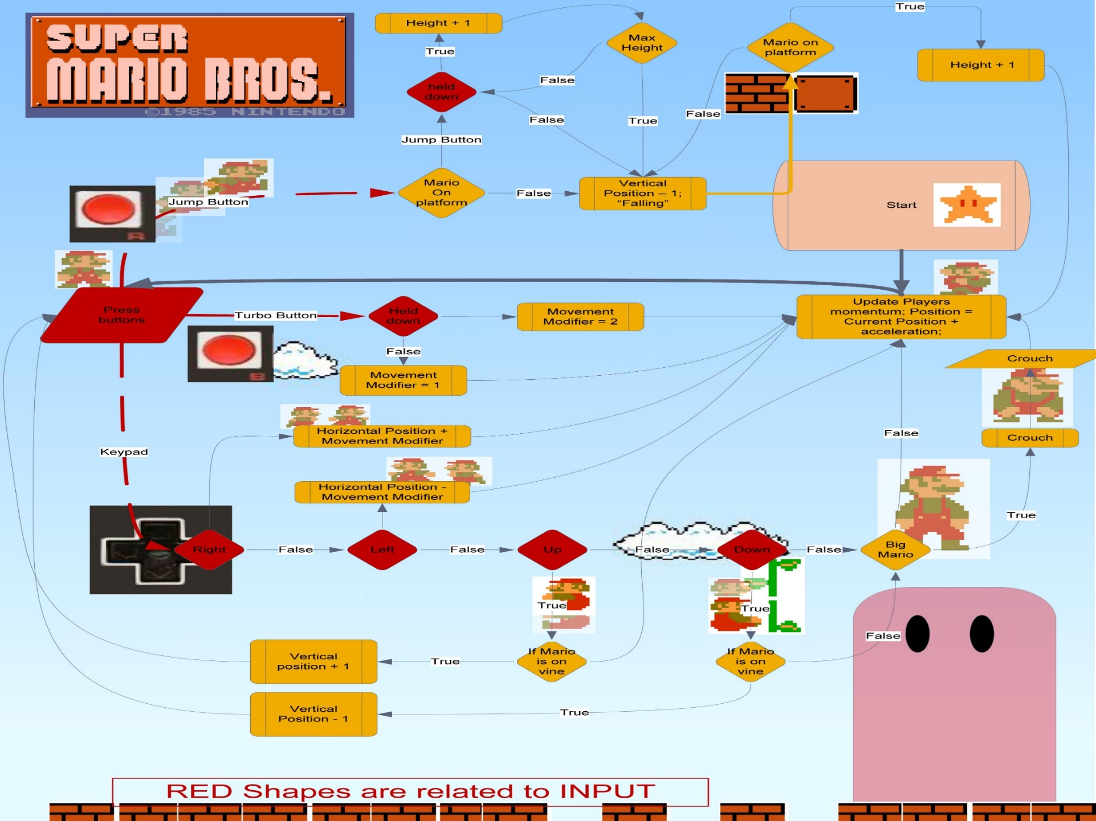
Super Mario Bros.

Slide 5
Logical Expressions
Several of C’s statements must test the value of an expression to see if it is “true” or “false.”
For example, an if statement might need to test the expression i < j; a true value would indicate that i is less than j.
In many programming languages, an expression such as i < j would have a special “Boolean” or “logical” type.
In C, a comparison such as i < j yields an integer: either 0 (false) or 1 (true).

Slide 6
Relational Operators
C’s relational operators:
< less than
> greater than
<= less than or equal to
>= greater than or equal to
These operators produce 0 (false) or 1 (true) when used in expressions.
The relational operators can be used to compare integers and floating-point numbers, with operands of mixed types allowed.

Slide 7
Relational Operators
The precedence of the relational operators is lower than that of the arithmetic operators.
For example, i + j < k - 1 means (i + j) < (k - 1).
The relational operators are left associative.

Slide 8
Relational Operators
The expression
i < j < k
is legal, but does not test whether j lies between i and k.
Since the < operator is left associative, this expression is equivalent to
(i < j) < k
The 1 or 0 produced by i < j is then compared to k.
The correct expression is i < j && j < k.

Slide 9
Equality Operators
C provides two equality operators:
== equal to
!= not equal to
The equality operators are left associative and produce either 0 (false) or 1 (true) as their result.
The equality operators have lower precedence than the relational operators, so the expression
i < j == j < k
is equivalent to
(i < j) == (j < k)

Slide 10
Logical Operators
More complicated logical expressions can be built from simpler ones by using the logical operators:
! logical negation
&& logical and
|| logical or
The ! operator is unary, while && and || are binary.
The logical operators produce 0 or 1 as their result.
The logical operators treat any nonzero operand as a true value and any zero operand as a false value.

Slide 11
Logical Operators
Behavior of the logical operators:
!expr has the value 1 if expr has the value 0.
expr1 && expr2 has the value 1 if the values of expr1 and expr2 are both nonzero.
expr1 || expr2 has the value 1 if either expr1 or expr2 (or both) has a nonzero value.
In all other cases, these operators produce the value 0.

Slide 12
Logical Operators
Both && and || perform “short-circuit” evaluation: they first evaluate the left operand, then the right one.
If the value of the expression can be deduced from the left operand alone, the right operand isn’t evaluated.
Example:
(i != 0) && (j / i > 0)
(i != 0) is evaluated first. If i isn’t equal to 0, then (j / i > 0) is evaluated.
If i is 0, the entire expression must be false, so there’s no need to evaluate (j / i > 0). Without short-circuit evaluation, division by zero would have occurred.

Slide 13
Logical Operators
Thanks to the short-circuit nature of the && and || operators, side effects in logical expressions may not always occur.
Example:
i > 0 && ++j > 0
If i > 0 is false, then ++j > 0 is not evaluated, so j isn’t incremented.
The problem can be fixed by changing the condition to ++j > 0 && i > 0 or, even better, by incrementing j separately.

Slide 14
Logical Operators
The ! operator has the same precedence as the unary plus and minus operators.
The precedence of && and || is lower than that of the relational and equality operators.
For example, i < j && k == m means (i < j) && (k == m).
The ! operator is right associative; && and || are left associative.

Slide 15
The if Statement
The if statement allows a program to choose between two alternatives by testing an expression.
In its simplest form, the if statement has the form
if ( expression ) statement
When an if statement is executed, expression is evaluated;
if its value is nonzero, statement is executed.
Example:
if (line_num == MAX_LINES)
line_num = 0;

Slide 16
The if Statement
Confusing == (equality) with = (assignment) is perhaps the most common C programming error.
The statement
if (i == 0) …
tests whether i is equal to 0.
The statement
if (i = 0) …
assigns 0 to i, then tests whether the result is nonzero.

Slide 17
The if Statement
Often the expression in an if statement will test whether a variable falls within a range of values.
To test whether 0 ≤ i < n:
if (0 <= i && i < n) …
To test the opposite condition (i is outside the range):
if (i < 0 || i >= n) …

Slide 18
Compound Statements
In the if statement template, notice that statement is singular, not plural:
if ( expression ) statement
To make an if statement control two or more statements, use a compound statement.
A compound statement has the form
{ statements }
Putting braces around a group of statements forces the compiler to treat it as a single statement.

Slide 19
Compound Statements
Example:
{ line_num = 0; page_num++; }
A compound statement is usually put on multiple lines, with one statement per line:
{
line_num = 0;
page_num++;
}
Each inner statement still ends with a semicolon, but the compound statement itself does not.

Slide 20
Compound Statements
Example of a compound statement used inside an if statement:
if (line_num == MAX_LINES)
{
line_num = 0;
page_num++;
}
Compound statements are also common in loops and other places where the syntax of C requires a single statement.

Slide 21
The else Clause
An if statement may have an else clause:
if ( expression ) statement else statement
The statement that follows the word else is executed if the expression has the value 0.
Example:
if (i > j)
max = i;
else
max = j;
if (i > j) max = i;
else max = j;

Slide 22
The else Clause
When an if statement contains an else clause, where should the else be placed?
Many C programmers align it with the if at the beginning of the statement.
Inner statements are usually indented, but if they’re short they can be put on the same line as the if and else:
if (i > j) max = i;
else max = j;

Slide 23
The else Clause
if (i > j)
if (i > k)
max = i;
else
max = k;
else
if (j > k)
max = j;
else
max = k;
It’s not unusual for if statements to be nested inside other if statements:
Aligning each else with the matching if makes the nesting easier to see.

Slide 24
The else Clause
To avoid confusion, don’t hesitate to add braces:
if (i > j)
{
if (i > k)
max = i;
else
max = k;
}
else
{
if (j > k) max = j;
else max = k;
}
if ( expression ) statement
((((x + y) < 10) && ((x/y) == 3)) || (z != 10))

Slide 25
The else Clause
if (i > j)
{
if (i > k)
{
max = i;
}
else
{
max = k;
}
}
else
{
if (j > k)
{
max = j;
}
else
{
max = k;
}
}
Some programmers use as many braces as possible inside if statements:
if (i > j)
{
if (i > k)
max = i;
else
max = k;
}
else
{
if (j > k) max = j;
else max = k;
}

Slide 26
The else Clause
Advantages of using braces even when they’re not required:
Makes programs easier to modify, because more statements can easily be added to any if or else clause.
Helps avoid errors that can result from forgetting to use braces when adding statements to an if or else clause.

Slide 27
Cascaded if Statements
A “cascaded” if statement is often the best way to test a series of conditions, stopping as soon as one of them is true.
Example:
if (n < 0)
printf("n is less than 0\n");
else
if (n == 0)
printf("n is equal to 0\n");
else
printf("n is greater than 0\n");

Slide 28
Cascaded if Statements
Although the second if statement is nested inside the first, C programmers don’t usually indent it.
Instead, they align each else with the original if:
if (n < 0)
printf("n is less than 0\n");
else if (n == 0)
printf("n is equal to 0\n");
else
printf("n is greater than 0\n");

Slide 29
Cascaded if Statements
This layout avoids the problem of excessive indentation when the number of tests is large:
if ( expression )
statement
else if ( expression )
statement
…
else if ( expression )
statement
else
statement

Slide 30
Program: Calculating a Broker’s Commission
When stocks are sold or purchased through a broker, the broker’s commission often depends upon the value of the stocks traded.
Suppose that a broker charges the amounts shown in the following table:
Transaction size Commission rate
Under $2,500 $30 + 1.7%
$2,500–$6,250 $56 + 0.66%
$6,250–$20,000 $76 + 0.34%
$20,000–$50,000 $100 + 0.22%
$50,000–$500,000 $155 + 0.11%
Over $500,000 $255 + 0.09%
The minimum charge is $39.

Slide 31
Program: Calculating a Broker’s Commission
The broker.c program asks the user to enter the amount of the trade, then displays the amount of the commission:
Enter value of trade: 30000
Commission: $166.00
The heart of the program is a cascaded if statement that determines which range the trade falls into.

Slide 32
#include <stdio.h>
int main(void){
float commission, value;
printf("Enter value of trade: ");
scanf("%f", &value);
if (value < 2500.00f)
commission = 30.00f + .017f * value;
else if (value < 6250.00f)
commission = 56.00f + .0066f * value;
else if (value < 20000.00f)
commission = 76.00f + .0034f * value;
else if (value < 50000.00f)
commission = 100.00f + .0022f * value;
else if (value < 500000.00f)
commission = 155.00f + .0011f * value;
else
commission = 255.00f + .0009f * value;
if (commission < 39.00f) commission = 39.00f;
printf("Commission: $%.2f\n", commission);
return 0;
}
broker.c

Slide 33
The “Dangling else” Problem
When if statements are nested, the “dangling else” problem may occur:
if (y != 0)
if (x != 0)
result = x / y;
else
printf("Error: y is equal to 0\n");
The indentation suggests that the else clause belongs to the outer if statement.
However, C follows the rule that an else clause belongs to the nearest if statement that hasn’t already been paired with an else.

Slide 34
The “Dangling else” Problem
A correctly indented version would look like this:
if (y != 0)
if (x != 0)
result = x / y;
else
printf("Error: y is equal to 0\n");

Slide 35
The “Dangling else” Problem
To make the else clause part of the outer if statement, we can enclose the inner if statement in braces:
if (y != 0)
{
if (x != 0)
result = x / y;
} else
printf("Error: y is equal to 0\n");
Using braces in the original if statement would have avoided the problem in the first place.

Slide 36
If-else Examples
int age; // Need a variable…
printf( "Please enter your age" );
scanf( "%d", &age ); /* The input is put in age */
if ( age < 100 )
{ /* If the age is less than 100 */
printf ("You are pretty young!\n" );
}
else if ( age == 100 )
{ /* I use else just to show an example */
printf( "You are old\n" );
}
else
{
printf( "You are really old\n" );
// Executed if no other statement is
}

Slide 37
If-else Examples (Contd.)
//checking whether remainder is 0 or not.
if((num%2)==0)
printf("%d is even.",num);
else
printf("%d is odd.",num);
return 0;

Slide 38
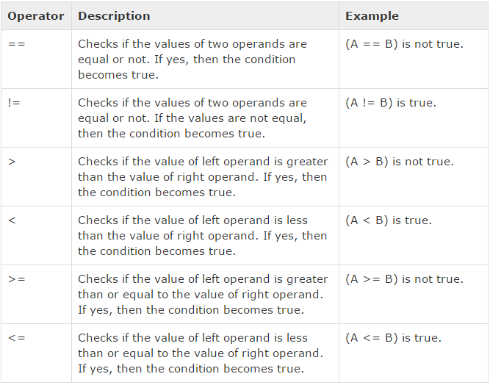
Relational Operators

Slide 39
Understand all the relational operators
int a = 21, b = 10, int c ;
if( a == b ) { printf("Line 1 - a is equal to b\n" ); }
else { printf("Line 1 - a is not equal to b\n" ); }
if ( a < b ) { printf("Line 2 - a is less than b\n" ); }
else { printf("Line 2 - a is not less than b\n" ); }
if ( a > b ) { printf("Line 3 - a is greater than b\n" ); }
else { printf("Line 3 - a is not greater than b\n" ); }
/* Lets change value of a and b */
a = 5; b = 20;
if ( a <= b ) { printf("Line 4 - a is either less than or equal to b\n" ); }
if ( b >= a ) {
printf("Line 5 - b is either greater than or equal to b\n" );
}

Slide 40
If-else Examples (Contd.)
bool test = false;
…
if((i > 35) && (i < 100))
{ …
test = false;
}
…
if ((i <= 35) || (i >= 100))
{ // Logical OR
…
test = true;
}
if (test)
{ // "if(test)" is equivalent to "if(test == true)"
…
}
if ( ! test ) { … }
…

Slide 41
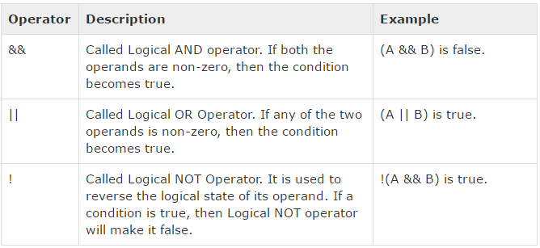
Logical Operators

Slide 42
int a = 5;
int b = 20;
int c ;
if ( a && b ) { printf("Line 1 - Condition is true\n" ); }
if ( a || b ) { printf("Line 2 - Condition is true\n" ); }
/* lets change the value of a and b */
a = 0;
b = 10;
if ( a && b ) { printf("Line 3 - Condition is true\n" ); }
else { printf("Line 3 - Condition is not true\n" ); }
if ( !(a && b) ) { printf("Line 4 - Condition is true\n" ); }

Slide 43
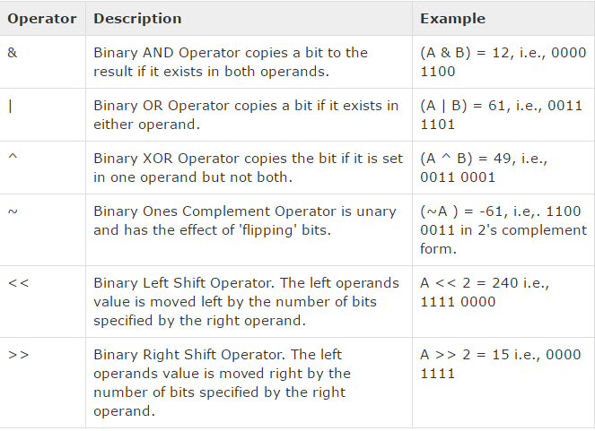
Bitwise Operators

Slide 44
understand all the bitwise operators
unsigned int a = 60; /* 60 = 0011 1100 */
unsigned int b = 13; /* 13 = 0000 1101 */
int c = 0;
c = a & b; /* 12 = 0000 1100 */
printf("Line 1 - Value of c is %d\n", c );
c = a | b; /* 61 = 0011 1101 */
printf("Line 2 - Value of c is %d\n", c );
c = a ^ b; /* 49 = 0011 0001 */
printf("Line 3 - Value of c is %d\n", c );
c = ~a; /*-61 = 1100 0011 */
printf("Line 4 - Value of c is %d\n", c );
c = a << 2; /* 240 = 1111 0000 */
printf("Line 5 - Value of c is %d\n", c );
c = a >> 2; /* 15 = 0000 1111 */
printf("Line 6 - Value of c is %d\n", c );

Slide 45
Conditional Expressions
C’s conditional operator allows an expression to produce one of two values depending on the value of a condition.
The conditional operator consists of two symbols (? and :), which must be used together:
expr1 ? expr2 : expr3
The operands can be of any type.
The resulting expression is said to be a conditional expression.

Slide 46
Conditional Expressions
The conditional operator requires three operands, so it is often referred to as a ternary operator.
The conditional expression expr1 ? expr2 : expr3 should be read “if expr1 then expr2 else expr3.”
The expression is evaluated in stages: expr1 is evaluated first; if its value isn’t zero, then expr2 is evaluated, and its value is the value of the entire conditional expression.
If the value of expr1 is zero, then the value of expr3 is the value of the conditional.

Slide 47
Conditional Expressions
Example:
int i= 1, j, k;
j = 2;
k = i > j ? i : j; /* k is now 2*/
k = (i >= 0 ? i : 0) + j; //k is now 3
The parentheses are necessary, because the precedence of the conditional operator is less than that of the other operators discussed so far, with the exception of the assignment operators.

Slide 48
Conditional Expressions
Conditional expressions tend to make programs shorter but harder to understand, so it’s probably best to use them sparingly.
Conditional expressions are often used in return statements:
return i > j ? i : j;

Slide 49
Conditional Expressions
Calls of printf can sometimes benefit from condition expressions. Instead of
if (i > j)
printf("%d\n", i);
else
printf("%d\n", j);
we could simply write
printf("%d\n", i > j ? i : j);
Conditional expressions are also common in certain kinds of macro definitions.

Slide 50
Boolean Values in C89
For many years, the C language lacked a proper Boolean type, and there is none defined in the C89 standard.
One way to work around this limitation is to declare an int variable and then assign it either 0 or 1:
int flag;
flag = 0;
…
flag = 1;
Although this scheme works, it doesn’t contribute much to program readability.

Slide 51
Boolean Values in C89
To make programs more understandable, C89 programmers often define macros with names such as TRUE and FALSE:
#define TRUE 1
#define FALSE 0
Assignments to flag now have a more natural appearance:
flag = FALSE;
…
flag = TRUE;

Slide 52
Boolean Values in C89
To test whether flag is true, we can write
if (flag == TRUE) …
or just
if (flag) …
The latter form is more concise. It also works correctly if flag has a value other than 0 or 1.
To test whether flag is false, we can write
if (flag == FALSE) …
or
if (!flag) …

Slide 53
Boolean Values in C89
Carrying this idea one step further, we might even define a macro that can be used as a type:
#define BOOL int
BOOL can take the place of int when declaring Boolean variables:
BOOL flag;
It’s now clear that flag isn’t an ordinary integer variable, but instead represents a Boolean condition.

Slide 54
Boolean Values in C99
C99 provides the _Bool type.
A Boolean variable can be declared by writing
_Bool flag;
_Bool is an integer type, so a _Bool variable is really just an integer variable in disguise.
Unlike an ordinary integer variable, however, a _Bool variable can only be assigned 0 or 1.
Attempting to store a nonzero value into a _Bool variable will cause the variable to be assigned 1:
flag = 5; /* flag is assigned 1 */

Slide 55
Boolean Values in C99
It’s legal (although not advisable) to perform arithmetic on _Bool variables.
It’s also legal to print a _Bool variable (either 0 or 1 will be displayed).
And, of course, a _Bool variable can be tested in an if statement:
if (flag) /* tests whether flag is 1 */
…

Slide 56
Boolean Values in C99
C99’s <stdbool.h> header makes it easier to work with Boolean values.
It defines a macro, bool, that stands for _Bool.
If <stdbool.h> is included, we can write
bool flag; /* same as _Bool flag; */
<stdbool.h> also supplies macros named true and false, which stand for 1 and 0, respectively, making it possible to write
flag = false;
…
flag = true;

Slide 57
Boolean value Example
#include <stdio.h>
#include <stdlib.h>
#include <stdbool.h>
int main(void) {
bool keepGoing = true; // Could also be `bool keepGoing = 1;`
if (keepGoing) {
printf("This will run as long as keepGoing is true.\n");
keepGoing = false; // Could also be `keepGoing = 0;`
}
printf("Stopping!\n");
return EXIT_SUCCESS;
}

Slide 58
The switch Statement
A cascaded if statement can be used to compare an expression against a series of values:
if (grade == 4)
printf("Excellent");
else if (grade == 3)
printf("Good");
else if (grade == 2)
printf("Average");
else if (grade == 1)
printf("Poor");
else if (grade == 0)
printf("Failing");
else
printf("Illegal grade");

Slide 59
The switch Statement
The switch statement is an alternative:
switch (grade)
{
case 4: printf("Excellent");
break;
case 3: printf("Good");
break;
case 2: printf("Average");
break;
case 1: printf("Poor");
break;
case 0: printf("Failing");
break;
default: printf("Illegal grade");
break;
}
if (grade == 4)
printf("Excellent");
else if (grade == 3)
printf("Good");
else if (grade == 2)
printf("Average");
else if (grade == 1)
printf("Poor");
else if (grade == 0)
printf("Failing");
else
printf("Illegal grade");

Slide 60
The switch Statement
A switch statement may be easier to read than a cascaded if statement.
switch statements are often faster than if statements.
Most common form of the switch statement:
switch ( expression )
{
case constant-expression : statements
…
case constant-expression : statements
default : statements
}

Slide 61
The switch Statement
The word switch must be followed by an integer expression—the controlling expression—in parentheses.
Characters are treated as integers in C and thus can be tested in switch statements.
Floating-point numbers and strings don’t qualify, however.

Slide 62
The switch Statement
Each case begins with a label of the form
case constant-expression :
A constant expression is much like an ordinary expression except that it can’t contain variables or function calls.
5 is a constant expression, and 5 + 10 is a constant expression, but n + 10 isn’t a constant expression (unless n is a macro that represents a constant).
The constant expression in a case label must evaluate to an integer (characters are acceptable).

Slide 63
The switch Statement
After each case label comes any number of statements.
No braces are required around the statements.
The last statement in each group is normally break.

Slide 64
The switch Statement
Duplicate case labels aren’t allowed.
The order of the cases doesn’t matter, and the default case doesn’t need to come last.
Several case labels may precede a group of statements:
switch (grade)
{
case 4:
case 3:
case 2:
case 1: printf("Passing");
break;
case 0: printf("Failing");
break;
default: printf("Illegal grade");
break;
}

Slide 65
The switch Statement
To save space, several case labels can be put on the same line:
switch (grade)
{
case 4: case 3: case 2: case 1:
printf("Passing");
break;
case 0: printf("Failing");
break;
default: printf("Illegal grade");
break;
}
If the default case is missing and the controlling expression’s value doesn’t match any case label, control passes to the next statement after the switch.

Slide 66
The Role of the break Statement
Executing a break statement causes the program to “break” out of the switch statement; execution continues at the next statement after the switch.
The switch statement is really a form of “computed jump.”
When the controlling expression is evaluated, control jumps to the case label matching the value of the switch expression.
A case label is nothing more than a marker indicating a position within the switch.

Slide 67
The Role of the break Statement
Without break (or some other jump statement) at the end of a case, control will flow into the next case.
Example:
switch (grade) {
case 4: printf("Excellent");
case 3: printf("Good");
case 2: printf("Average");
case 1: printf("Poor");
case 0: printf("Failing");
default: printf("Illegal grade");
}
If the value of grade is 3, the message printed is
GoodAveragePoorFailingIllegal grade

Slide 68
The Role of the break Statement
Omitting break is sometimes done intentionally, but it’s usually just an oversight.
It’s a good idea to point out deliberate omissions of break:
switch (grade) {
case 4: case 3: case 2: case 1:
num_passing++;
/* FALL THROUGH */
case 0: total_grades++;
break;
}
Although the last case never needs a break statement, including one makes it easy to add cases in the future.

Slide 69
Program: Printing a Date in Legal Form
Contracts and other legal documents are often dated in the following way:
Dated this __________ day of __________ , 20__ .
The date.c program will display a date in this form after the user enters the date in month/day/year form:
Enter date (mm/dd/yy): 7/19/14
Dated this 19th day of July, 2014.
The program uses switch statements to add “th” (or “st” or “nd” or “rd”) to the day, and to print the month as a word instead of a number.

Slide 70
#include <stdio.h>
int main(void)
{
int month, day, year;
printf("Enter date (mm/dd/yy): ");
scanf("%d /%d /%d", &month, &day, &year);
printf("Dated this %d", day);
switch (day)
{
case 1: case 21: case 31:
printf("st"); break;
case 2: case 22:
printf("nd"); break;
case 3: case 23:
printf("rd"); break;
default: printf("th"); break;
}
printf(" day of ");
date.c

Slide 71
switch (month) {
case 1: printf("January"); break;
case 2: printf(“February”); break;
case 3: printf("March"); break;
case 4: printf("April"); break;
case 5: printf("May"); break;
case 6: printf("June"); break;
case 7: printf("July"); break;
case 8: printf("August"); break;
case 9: printf("September"); break;
case 10: printf("October"); break;
case 11: printf("November"); break;
case 12: printf("December"); break;
}
printf(", 20%.2d.\n", year);
return 0;
}

Slide 72
Program example
#include <stdio.h>
int main(int argc, char *argv[]) {
int num;
printf("\nEnter any number to check even or odd :");
scanf("%d", &num);
(num%2==0) ? printf(“%d is EVEN\n”, num) : printf("%d is ODD\n", num);
return 0;
}

Slide 73
Program Example
#include <stdio.h>
int main()
{
int numb1, numb2;
printf("Enter two integers to check\n");
scanf("%d %d",&numb1,&numb2);
if (numb1 == numb2) //checking whether two integers are equal.
printf("Result: %d = %d",numb1,numb2);
else
if (numb1 > numb2) //checking whether numb1 is greater than numb2.
printf("Result: %d > %d",numb1,numb2);
else
printf("Result: %d > %d",numb2,numb1);
return 0;
}

Slide 74
char grade = ‘B’; // what if grade= ‘F’;
switch(grade) {
case 'A' :
printf("Excellent!\n" );
break;
case 'B' :
case 'C' :
printf("Well done\n" );
break;
case 'D' :
printf("You passed\n" );
break;
case 'F' : printf("Better try again\n" );
default : printf("Invalid grade\n" );
}
printf("Your grade is %c\n", grade );
Output=?

Slide 75
int invalidOperator = 0;
char operator;
float number1, number2, result;
printf("Enter two numbers and an operator in the format\n");
printf(" number1 operator number2\n");
scanf("%f %c %f", &number1, &operator, &number2);
if(operator == '*') result = number1 * number2;
else if(operator == '/') result = number1 / number2;
else if(operator == '+') result = number1 + number2;
else if(operator == '-') result = number1 - number2;
else invalidOperator = 1;
if( invalidOperator != 1 )
printf("%f %c %f is %f\n", number1, operator, number2, result );
else printf("Invalid operator.\n");
Sample Program Output
Enter two numbers and …
number1 operator number2
23.2 + 12
23.2 + 12 is 35.2

Slide 76
int invalidOperator = 0;
char operator;
float number1, number2, result;
…
if(operator == '*') result = number1 * number2;
else if(operator == '/') result = number1 / number2;
else if(operator == '+') result = number1 + number2;
else if(operator == '-') result = number1 - number2;
else invalidOperator = 1;
if( invalidOperator != 1 )
…
else printf("Invalid operator.\n");
Improve this statement!

